Slide 1
CRYPTOCURRENCY DASHBOARD

Slide 2
ABOUT PROJECT
A cryptocurrency is a digital or virtual currency that is secured by cryptography, which makes it nearly impossible to counterfeit or double-spend. Many cryptocurrencies are decentralized networks based on blockchain technology, a distributed ledger enforced by a disparate network of computers. The project is the analysis of different types of cryptocurrency over various years.

Slide 3
ABOUT Data SET
The dataset has one csv file for each currency. Price history is available on a daily basis from April 28, 2013 to December 30, 2022. This dataset has the historical price information of some of the top crypto currencies by market capitalization.

Slide 4
DETAILS OF DATA SET
DATE - The DATE describes the date of observations.
OPEN - The OPEN is the Opening Price on the given day.
HIGH - The HIGH is the highest price on the given day.
LOW - The LOW is the lowest price on the given day.
CLOSE - The CLOSE is the closing price on the given day.
VOLUME - The VOLUMNE is the volume of transactions on the given day.
MARKET CAP - The MARKET CAP is the market capitalization in USD.

Slide 5












CRYPTOCURRIENCIES USED
AAVE COIN
COSMOS COIN
IOTA COIN
BINANCE COIN
CRYPTO.COM COIN
MONOCOIN
DOGE COIN
LITE COIN
BITCOIN
CARDANO COIN
EOS COIN
NEM COIN

Slide 6











CRYPTOCURRIENCIES USED
SOLANA COIN
USD COIN
COINWRAPPED BITCOIN
UNISWAP COIN
TETHER
XRP COIN
STELLAR COIN
TRON COIN
POLKADOT COIN
CHAINLINK COIN
ETHERIUM

Slide 7
INSIGHTS TO BE FOUND out?
What is the Final Close Price?
What is the highest close price?
What is the lowest close price?
What is the average daily volume?
What is comparison of Close Price within selected time?
What is Average Volume by Date range?
What is Price Comparison table of various cryptocurrencies?
Who are the best performers in last 30 Days and 365 Days?
Who are the worst performers in last 30 Days and 365 Days?
What is Price correlation of various cryptocurrencies?

Slide 8
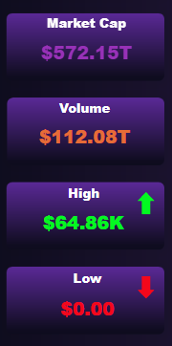
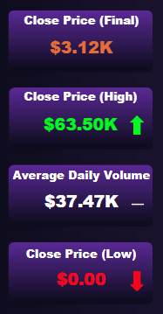
VISUAL ANALYTICS AND FINDINGS
SUMMARY OF DATA:
The dataset encompasses comprehensive data on market capitalization, trading volume, and price variations, providing insights into the overall cryptocurrency market dynamics.
Key data points such as high, low, and average close prices enable the identification of trends and patterns, aiding in making informed decisions and understanding market fluctuations.

Slide 9
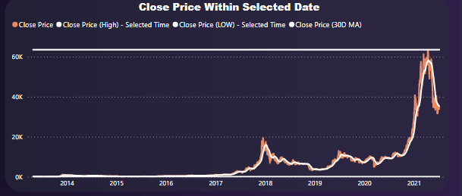
OVERALL ANALYSIS
CLOSE PRICE WITHIN SELECTED DATE:
The line chart on Close price within selected date displays the trend of the closing prices of cryptocurrencies within a specified date range, providing valuable insights on market performance.

Slide 10
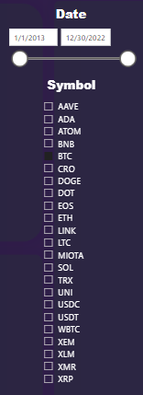
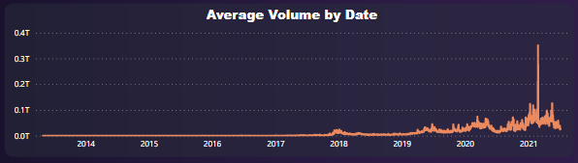
AVERAGE VOLUME BY DATE:
The Average volume by Date line chart showcases the trend of daily trading volumes across different dates, enabling the identification of periods with high or low trading activity. The Crypto symbols slicer and date slicer allow for interactive filtering and analysis, empowering users to explore specific cryptocurrencies and date ranges for deeper insights.

Slide 11
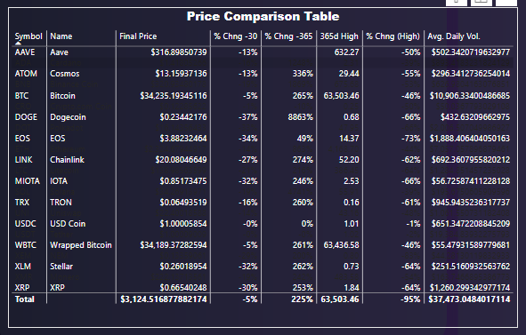
PRICE COMPARISON TABLE:
The Price Comparison Table graph provides a comprehensive overview of various cryptocurrencies, allowing for easy comparison of their prices and performance. It enables users to quickly identify the top performers and gain insights into the relative value and trends within the cryptocurrency market.

Slide 12
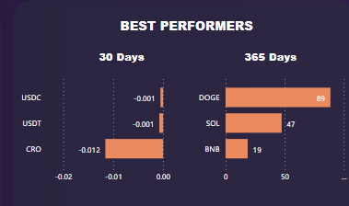
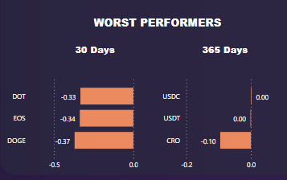
BEST PERFORMERS
The Clustered bar chart showcasing the Best Performers in the last 30 days highlights the top-performing cryptocurrencies during that period, providing insights into their growth and market performance. Similarly, the Clustered bar chart for the last 365 days identifies the cryptocurrencies that have excelled over the long term, offering a broader perspective on sustained performance and trends.
WORST PERFORMERS
The Clustered bar chart illustrating the Worst Performers in the last 30 days highlights the cryptocurrencies that have experienced the lowest performance during that timeframe, offering insights into their challenges and potential areas of improvement. Similarly, the Clustered bar chart for the last 365 days identifies the cryptocurrencies that have struggled over a longer duration, providing a comprehensive view of their underperformance and market trends.

Slide 13
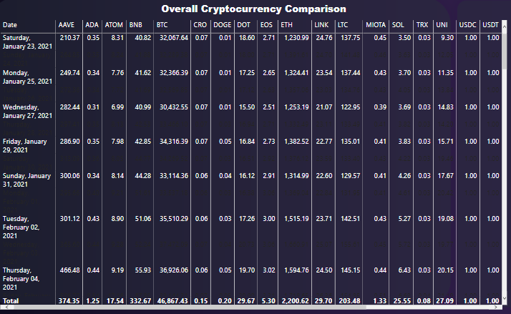
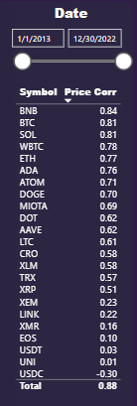
OVERALL ANALYSIS
The Overall Cryptocurrency Comparison Table presented as a Matrix provides a comprehensive view of the performance and correlation of cryptocurrencies based on the selected date range. By incorporating data such as Date, Symbol, and Value, along with slicers for date filtering and a table showcasing Symbol and Price Correlation, it allows for detailed analysis and comparison of cryptocurrencies to identify patterns and relationships in the market.

Slide 14
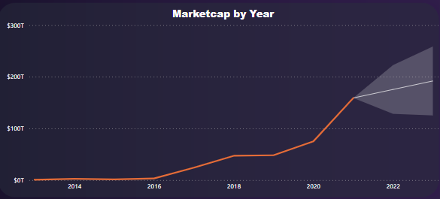
CRYPTOCURRENCY FORECASTING
MARKETCAP BY YEAR WITH FORECASTING:
The Market Cap by Year with Forecasting line chart showcases the historical market capitalization of cryptocurrencies from 2013 to 2021, providing insights into their growth and trends over time. With the inclusion of a forecast for 2022 - 2023, it offers a glimpse into the potential future performance and market dynamics, aiding in informed decision-making and strategic planning.

Slide 15
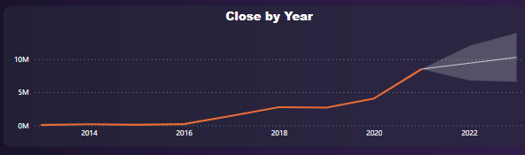
CLOSE BY YEAR WITH FORECASTING:
The Close by Year with Forecasting line chart visualizes the historical closing prices of cryptocurrencies from 2013 to 2021, offering valuable insights into their price trends and fluctuations over the years. With the inclusion of a forecast for 2022 - 2023, it provides an estimation of potential future price movements, aiding in investment decision-making and market analysis.

Slide 16
Project SUMMARY
This cryptocurrency analysis project leverages Power BI to provide valuable insights into the performance and trends of various cryptocurrencies. Through comprehensive visualizations, including line charts, tables, and bar charts, it enables users to explore market dynamics, compare prices, identify top and worst performers, and analyze correlations. The project's data-driven approach empowers investors and enthusiasts to make informed decisions, understand market fluctuations, and navigate the ever-evolving world of cryptocurrencies.

Slide 17
THANKYOU!

